Slide 1

Python Level 2
Lesson 6: Pip! Pip! Hooray!

Slide 2
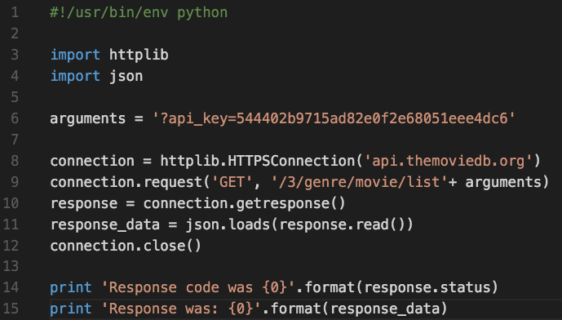

Last time

Slide 3
Pip Installs Packages
Python Package Index: https://pypi.python.org/pypi
To install a package:
pip install <packagename>
For a specific version:
pip install <packagename>=<version>
Eg: pip install mypackage=0.1.0
You know what’s coming…

Slide 4
Pip Installs Packages
Python Package Index: https://pypi.python.org/pypi
To install a package:
pip install <packagename>
You know what’s coming…
There’s a problem using pip - what is it?

Slide 5
Version Conflicts, System conflicts
What happens if
program A needs version 1 of a module
Program B needs version 2 of the same module
The solution: virtualenv
pip install virtualenv

Slide 6
Creating a new virtual environment
OS X:
virtualenv lesson7
source lesson7/bin/activate
Windows:
virtualenv lesson7
lesson7\Scripts\activate
Your prompt will change to reflect you’ve started your virtual environment
PyCharm user? I’ll show you.
Other IDEs, you’re on your own – sorry!

Slide 7
Using our virtual environment
We’re going to need a new module for the rest of today’s class:
Activate your virtual environment if you haven’t already
Install the module “web.py” (that’s its literal name)
Python 3 users: You need to install version 0.40.dev1 of web.py

Slide 8
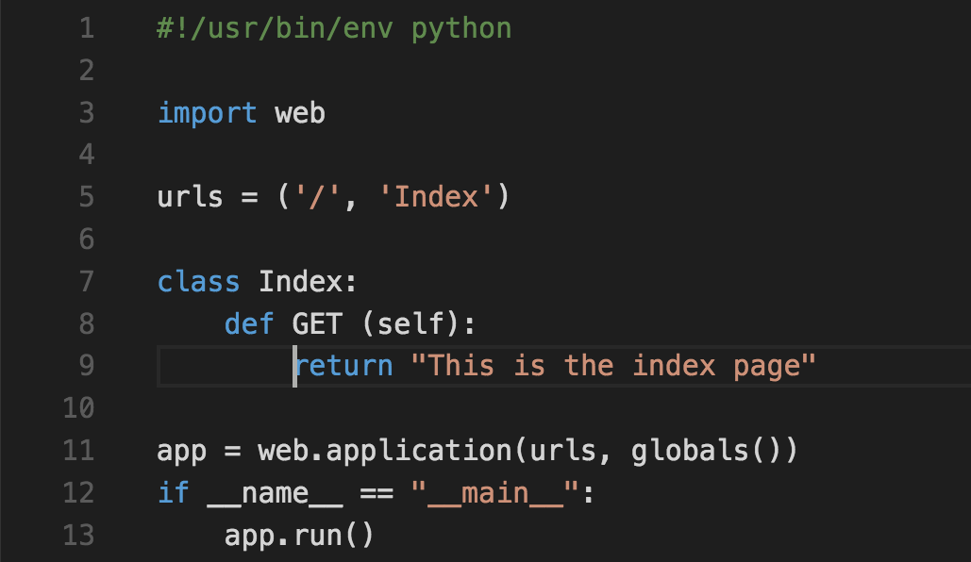
Building a web server

Slide 9
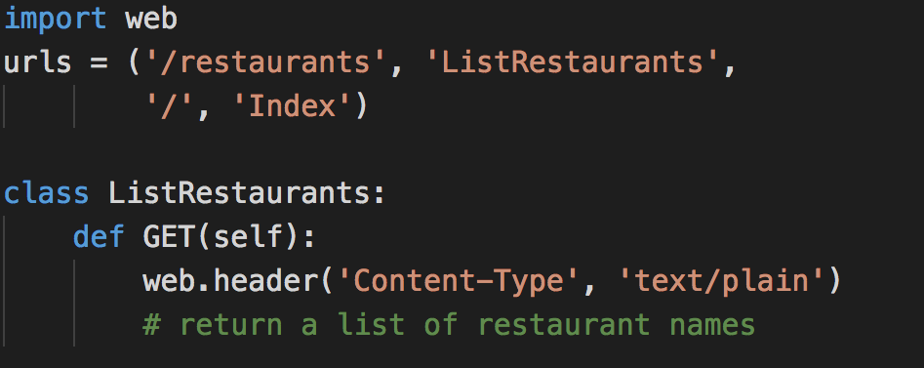
Passing Request data in

